Slide 1


FRONTEND ET
By Aakash Jha
Roll:- 2110990005, G5, CSE 3rd Year
Course Instructor:- Lavish Arora Sir

Slide 2
About the project
Some key features
Screenshots
Conclusions
Index

Slide 3

Introduction to the Project
Web-based e-commerce platform built with HTML, CSS, and JavaScript
Category wise products
Includes login and sign-up capabilities
Search Functionality to search among products.
Features a shopping cart for easy product management
Incorporates a support ticket system for customer assistance

Slide 4

Key features of the project
A summary of all the key features available in the website

Slide 5
Application Storage
Styling
LocalStorage usage for data storage & Auth Management
Cart functionality for users
Customizable global themes
Effective user state management
Distinct style sheets for different styling
Unified design system with a single style sheet
Individual style sheets for specific pages, maintaining global design consistency
Scripting
Scripting for user interactions
Automatic redirection to sign-in for non-logged-in users
Support Tickets & Cart Management System

Slide 6



Technology Stack
HTML 5
JavaScript
CSS / CSS3
Tailwind

Slide 7

Login

Slide 8
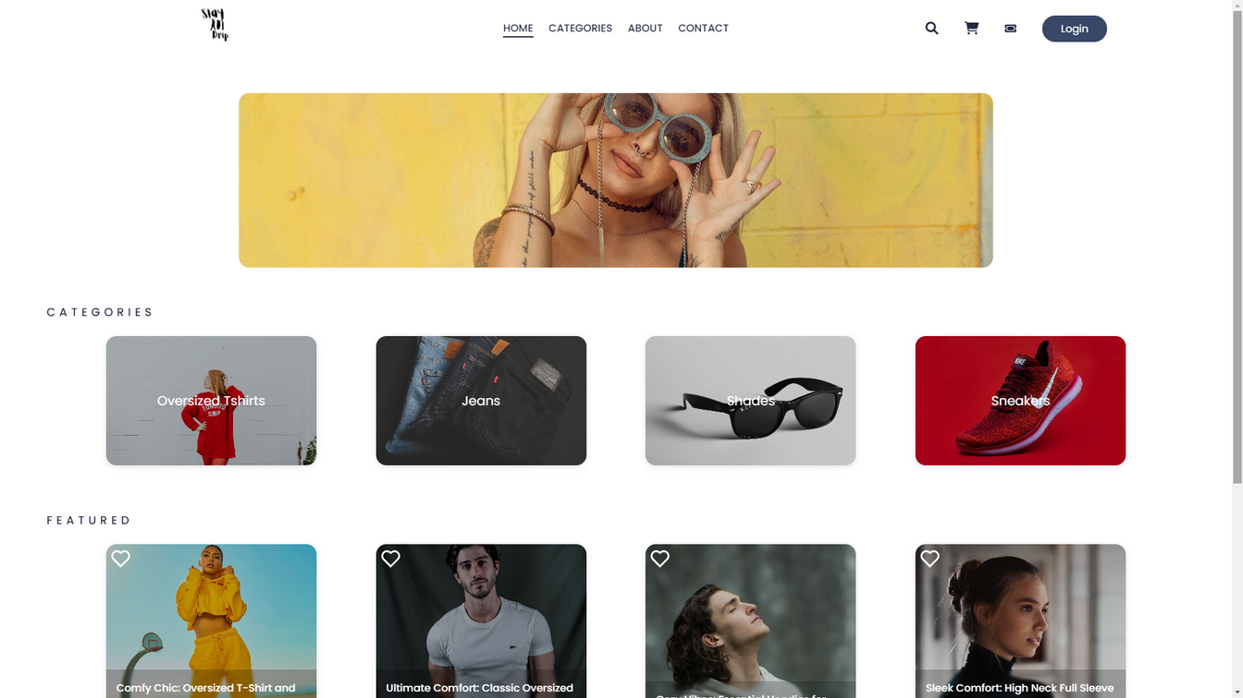
HOME

Slide 9
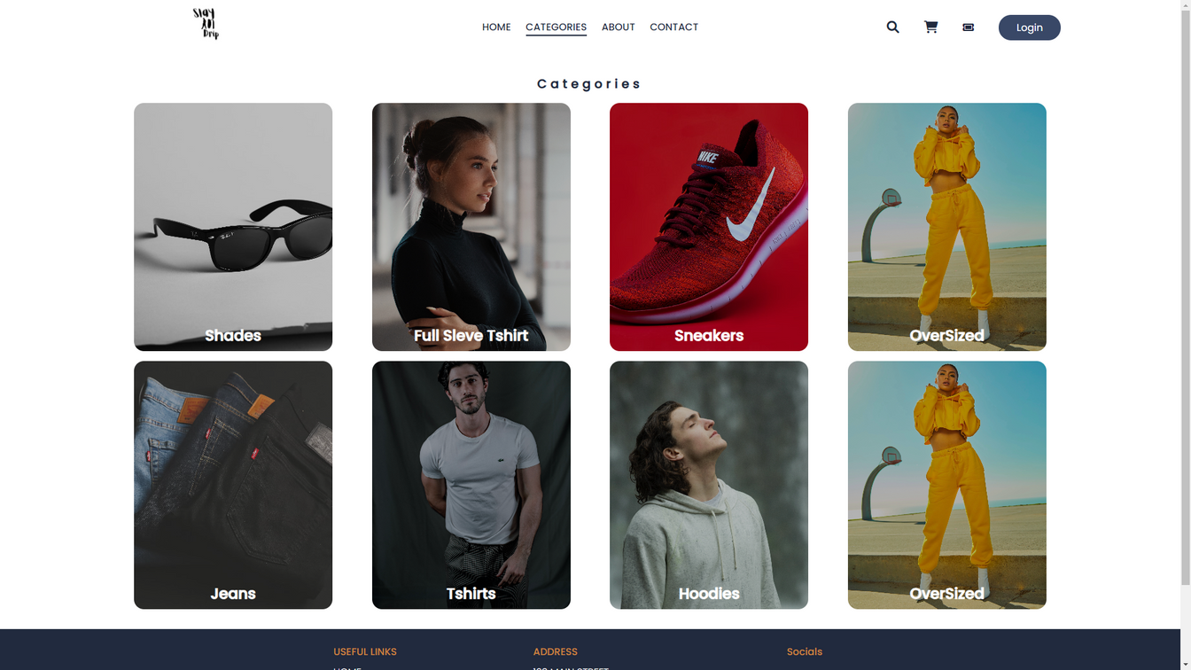
Categories

Slide 10
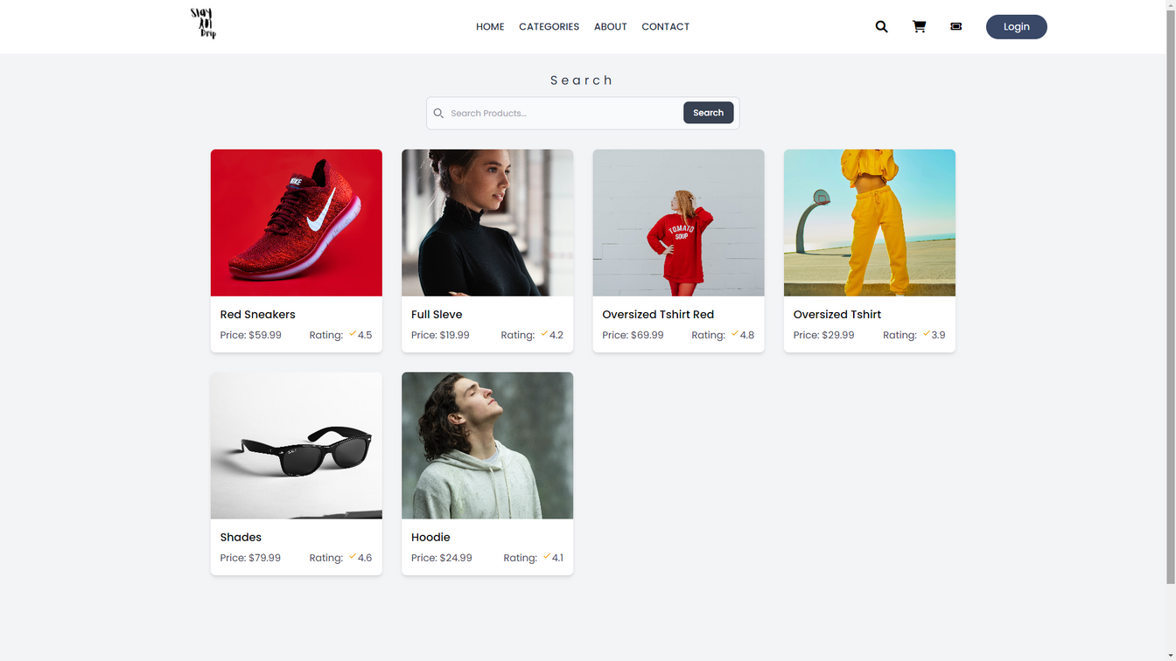
Search

Slide 11
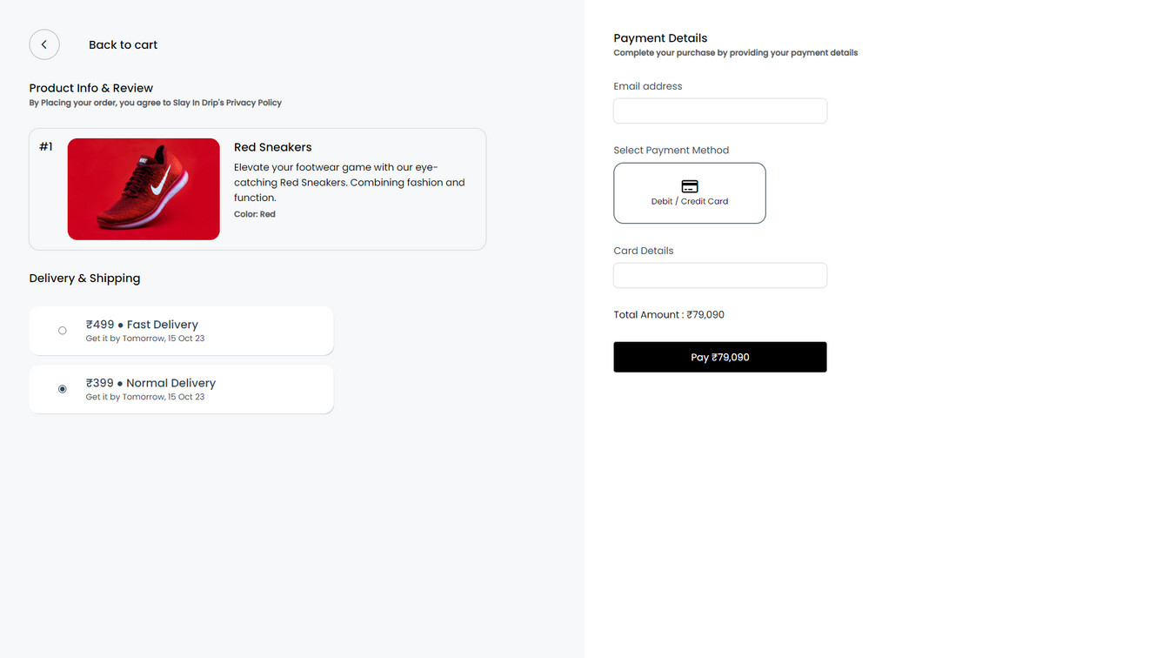
Checkout

Slide 12
Live Website URL
https://1tsak.github.io/slayInDrip/

